Slide 1
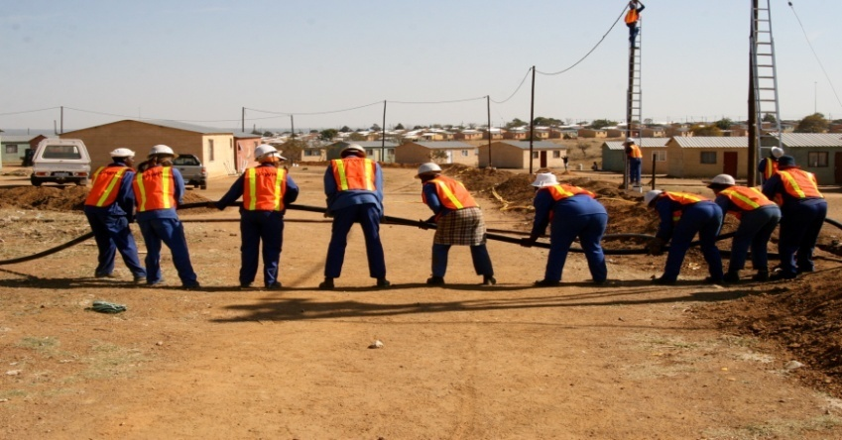
Expanded Public Works Programme EPWP 4th Summit Commissions Discussions Template

Slide 2
Commission 01: EPWP Institutional Arrangements
Issue | Existing structures | Action | Responsibility | Time Frames
How to streamline and improve the institutional arrangements in EPWP? (with focus of introducing convergence to avoid duplication at coordination level) | PSC DSC PSCC IGR CWP Reference groups (District Level) NSS PPMT CWP Provincial Coordinating Forum (PCF) | EPWP targets to be included in the Performance Agreements of the HODs/MMs. Protocol agreements to be signed with political heads Ensure synergies between the CWP and NPO | Accounting Officers (HOD’s & Premier MEC Mayors National Minister DPW NDPW | April 2015 April 2015
Notes:
In setting the scene the facilitator should cover:
Current institutional arrangement in EPWP,
SWOT analysis of the existing institutional arrangement,

Slide 3
Commission 01: EPWP Institutional Arrangements
Issue | Action | Responsibility | Time Frames
How should the EPWP be institutionalised within the PEP IMC and the Provincial EPWP Political Structures? (Roles and responsibilities of each role-player) | The current existing structures are still adopted and further discussions around the PEP IMC to be conducted (IGR Forum; HOD’s Forum; EXCO (MEC’s & Premier); Municipal Political Committee) (Note: the EC model (EPWP Political & Technical Committees) to be treated as a pilot) EPWP to be a standing item in the different political forums | National DPW (IMC) Provincial Coordinators | 30 June 2015
Notes:
In setting the scene the facilitator should cover:
Current institutional arrangement in EPWP,
SWOT analysis of the existing institutional arrangement,

Slide 4
Commission 01: EPWP Institutional Arrangements
Issue | Proposed | Action | Responsibility | Time Frames
How to ensure that sectoral and sphere structures engage effectively? | Integration at sector level and across the sphere of government. Coordination should start at public body level e.g. public bodies structures should have a representative of the four sectors Public body representatives will participate from regional (DSC/RSC) to provincial level (PSCC) Representation will cascade to NSCC level | Strengthening of the PSC, PSCC, DSC, Municipal Structures Provincial coordinators to participate in the HOD’s forum and the IGR Ensure participation of the Provincial Coordinator in all sectoral meetings. NSS to have a sector coordinator and establish a single structure (Provincial Coordinating Forum –CWP & Provincial Programme Management Team - NPO) | Provincial Coordinators National Coordinator/ COGTA | 31 March 2015
Notes:
In setting the scene the facilitator should cover:
Current institutional arrangement in EPWP,
SWOT analysis of the existing institutional arrangement,

Slide 5
Cont’d..commission 01: EPWP Institutional Arrangements
Issue | Action | Responsibility | Time Frames
What strategies should be used to prioritise EPWP in IDPs and Provincial Plans? | Departments to present their project plans to municipalities for inclusion into the IDP Ensure the participation of sector departments in the IDP planning and review processes Ensure that EPWP Projects are identified at Integrated Development Planning stage Alignment of MIG projects to EPWP | Mayor and Municipal Managers Municipal Technical Support | Ongoing
Notes:
In setting the scene the facilitator should cover:
Current institutional arrangement in EPWP,
SWOT analysis of the existing institutional arrangement,

Slide 6
Cont’d..commission 01: EPWP Institutional Arrangements
Issue | Action | Responsibility | Time Frames
How can the EPWP use protocols, policies and incentive agreements to improve accountability and implementation of the programme? | Include the EPWP targets in the performance agreements of the accounting officers. Review of the EPWP Policies EPWP policies to be cascaded to departments Continuous monitoring of the agreements Development of a tool (score cards) to monitor progress and compliance The Protocol agreements should be inclusive of all EPWP obligations e.g. overall targets, incentive grant, policies etc. | Provincial coordinators NDPW | 31 March 2015 – (Departments) 30 June 2015 (Municipalities)
Notes:
In setting the scene the facilitator should cover:
Current institutional arrangement in EPWP,
SWOT analysis of the existing institutional arrangement,

Slide 7
Cont’d..commission 01: EPWP Institutional Arrangements
Issue | Action | Responsibility | Time Frames
Notes:
In setting the scene the facilitator should cover:
Current institutional arrangement in EPWP,
SWOT analysis of the existing institutional arrangement,

